Slide 1
CMPE 220
Class 28 – Review for Final
Notes:
Let’s talk about history.
California State Railroad Museum – 1976 - docents worked on original steam engines.

Slide 2
Development Tools

Slide 3
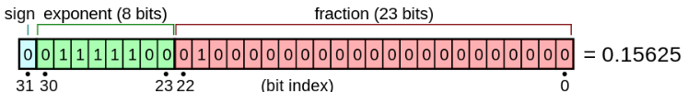
Early History
1940s: Machine code (binary)
1940s-1050s: Assembly Language
1950s: First high level language compilers (FORTRAN & COBOL)
Early computers: Binary Coded Decimal (BCD) Arithmetic
Advantages – why is is still supported
1960s: Binary integer arithmetic
IBM/360 – 1965
Floating Point Arithmetic – IEEE standard

Slide 4
Character Sets
7-bit ASCII (American Standard Code for Information Interchange)
8-bit Extended ASCII (multiple variants)
EBCDIC (Extended Binary Coded Decimal Interchange Code )
Unicode – 1987
Over 160,000 characters (glyphs)
UTF-8 (variable length)
UTF-16

Slide 5
Machine Architectures
Addressing Modes
Direct
Offset
Indexed
Indirect
Complex Instruction Set Computer (CISC)
Reduced Instruction Set Computer (RISC)
Microprogrammed Computers
Instruction Pipelining

Slide 6
RISC versus CISC
Reduced Instruction Set Computer
One clock-cycle per instruction
Effective pipelining
Fewer addressing modes
Requires more instructions per program (more RAM)
Lower gate count
Lower energy use
Complex Instruction Set Computer
Multiple / variable clock-cycles per instruction
More addressing modes
Requires fewer instructions per program (less RAM)
Higher gate count – more chip real estate
Higher energy use

Slide 7
Development Tools

Slide 8
Building Software
High Level Language Source Code (e.g. C++)
Assembly Language Source Code
Object file (binary machine code and tables)
Compiler
Assembler
Executable
file
In-Memory
Code
Linker
Loader
Hardware Execution

Slide 9
Development Tools
Assemblers
Macro-Processors
Compilers
Type of optimization
Optimization techniques
Interpreters
Linkers
Dynamic Linking – advantages
Loaders
Absolute loaders
Relocating Loaders

Slide 10
Development Tools
Shell Scripting
Make
Integrated Development Environments
Smart editors
Debuggers
Breakpoints
Version control
Check in / check out
Form & Merge

Slide 11
Development Tools
Frameworks
Advantages
Model View Controller (MVC) architecture
Model-View-ViewModel (MVVM) architecture
Inversion of Control & Callbacks
Event driven programming

Slide 12
Assemblers (nomenclature)
Assembler: converts assembly language to binary machine code
Two-Pass assembler
Macro Assembler: allows the programmer to define new instructions that the assembler “expands” into the actual instruction set This does not create new machine instructions
High Level Assembler: an assembler that includes certain high-level statements – such as IF/THEN/ELSE statements or loops – that don’t correspond direction to machine instructions
Cross Assembler: an assembler that runs on one machine, but generates binary machine code for a different machine
Micro Assembler: converts microassembly source code into microcode… the low level code that implements the machine instruction set

Slide 13
Compiler Architecture
Scanner (aka tokenizer, lexical analyzer)
FSM implementation
Parser (aka syntax analyzer)
Formal Grammars (BNF)
Parse Trees
Code Generator (aka semantic processor)

Slide 14
Software Development Life Cycle (SDLC)
A software development life cycle (SDLC) model is a conceptual framework describing all activities in a software development project from planning to maintenance.
Major Models
None
Waterfall (traditional)
Spiral
Agile / Scrum
DevOps

Slide 15
Types of Software Development
 | Applications | Web Applications | Software Development Tools | Servers (FTP, Web, Database, Email) | Operating Systems | Embedded Systems
Knowledge of application | YES | YES |  |  |  | YES
Knowledge of hardware |  |  | YES |  | YES | YES
Knowledge of standards |  | MAYBE | YES | YES | MAYBE
Performance Sensitive |  | YES |  | YES | YES | YES
Memory Sensitive |  |  |  |  | YES | YES
Process Management |  | MAYBE |  | YES | YES

Slide 16
Software Development Processes
 | Applications | Web Applications | Software Development Tools | Servers (FTP, Web, DB, Email) | Operating Systems | Embedded Systems
Formal Specifications | VARIES | VARIES | YES | YES | YES | VARIES
Languages | ANY | PHP, JavaScript, Ruby, Python | ANY | C, C++, JAVA | C, C++, JAVA, Assembly | Assembly, C, C++, Python, Ada, Rust, Go
Release cycles | RAPID | VERY RAPID | SLOW | MODERATE | SLOW | SLOW
Testing (Risk) | VARIES | VARIES | EXTENSIVE | EXTENSIVE | EXTENSIVE | VARIES

Slide 17
Software Development Processes: Fit
The best “fit” for developing a particular type of software is a matter of opinion, and based on specific circumstances. The table below is intended as a basis for discussion.
 | Applications | Web Applications | Software Development Tools | Servers (FTP, Web, DB, Email) | Operating Systems | Embedded Systems
Waterfall | VARIES | NO | YES | YES | YES | YES
Spiral | VARIES | NO | YES | YES | YES | YES
Agile | VARIES | YES | NO | YES | NO | NO
DevOps | VARIES | YES | NO | YES | YES | NO

Slide 18
Operating Systems

Slide 19
What Does a Modern Operating System Do?
Process Management
Fork & Exec
Scheduling and Dispatching
Interprocess Communications
Input / Output (I/O) Management
I/O blocks
Interrupts
Memory Management
MMUs & Address mapping
Virtual Memory & Swapping
File System Management
Disk fragmentation
System Functions and Kernel Mode
User Interaction – (maybe)
Networking

Slide 20
Types of Operating Systems
Batch / Single-Process (early computers – 1940s-50s)
Multi-Programming Systems (“modern” computers – last 1960s)
Multi-Processor Systems
Distributed Operating Systems
Network Operating Systems

Slide 21
Types of Operating Systems
Embedded Systems
Limited Memory
No Disks
Real-Time Systems
Predictability more important than speed
Cloud Systems
Network OS meets Virtualization
Mobile Systems
Android versus iOS
Security issues
No Disks (but mass storage)
Novel I/O

Slide 22
Unix / Linux / POSIX
Importance
Evolution
Standards

Slide 23
Virtual Machines
Abstract the hardware of a single computer system.
Create several different execution environments.
Each environment can have its own operating system.
Each environment believes it has the entire physical system.
Processes
Processes
Processes
Kernel
Kernel
Kernel
VM1
VM2
VM3
Virtual Machine Manager
Host Operating System
Physical Machine

Slide 24
Security
Breach of confidentiality
Unauthorized reading of data
Breach of integrity
Unauthorized modification of data
Breach of availability
Unauthorized destruction of data
Theft of service
Unauthorized use of resources
Denial of service (DOS)
Prevention of legitimate use

Slide 25
Attack Modalities
Masquerading
Replay Attack
Session Hijacking
Man-in-the-Middle
Trojan Horse
Virus
Trapdoors
Logic Bombs
Code Insertion
People Threats!

Slide 26
Mitigation of Security Risks
Use secure protocols
Require strong passwords / long passwords
Require two-factor authentication
Restrict admin access to the server
Restrict physical access to the server
Set file permissions to the least access (POLA)
Keep all system software up to date
Block unnecessary ports
Run regular file checksums
Run anti-virus software
Make regular backups

Slide 27



One-Way Encryption & Public Key Cryptography
Jill sends to each recipient.
Bart can’t decrypt the messages to recover the confidential data 7 because he doesn’t know the shared secrets.
Shared secret with Jill: 100
Mark
107
Shared secret with John: 400
407
Shared secret with Jill: 400
Jill
John
Shared secret with Mark: 100
Bart

Slide 28
Optimization
Architecture & Design
Algorithms & Data Structures
Compiler Optimization
Speed
Size
Power Consumption
Reduce Kernel Mode Switches
System Tuning
Monitoring Tools
Hardware Configuration Tuning
Housekeeping
File System Optimization
Server / Task Allocation

Slide 29
System Utilities & Management
System Management
Network Management
VPNs
Maintenance
Command Line Shells
Windows Registry
User Utilities

Slide 30
Servers

Slide 31
The Client / Server Model
A server is a program that runs on a computer, providing a specific service to other program(s), called clients
In the POSIX world, a server is often called a daemon (demon)
a long-running background process that answers requests for services
The server program may launch multiple processes, as needed
The software that makes up a server may - or may not - have system dependencies
Examples:
Database Management System
FTP Server
Mail Server
Web Server
Windowing System

Slide 32
OSI Versus TCP/IP Models
OSI Reference Model
TCP/IP Model
OSI model provides a clear distinction between application, presentation, and session services.
TCP/IP groups these as a single Application layer
In the OSI model, the data link layer and physical are separate layers.
TCP/IP groups these as a single Network layer
Application
Application
Presentation
Session
Transport
Transport
Network
Internet
Data Link
Network
Physical

Slide 33
TCP/IP
Transmission Control Protocol / Internet Protocol
Based on research done by the Army Research Projects Agency (ARPA) in the 1960s and 1970s
Standardized by the US Department of Defense in 1982
Administered by the Internet Engineering Task Force (IETF) since 1989
Four Layers:
Application Layer
Transport Layer
Internet Layer
Network Interface Layer

Slide 34
TCP/IP Enabled the Internet
Ubiquitous: supported by virtually every operating system
Essentially makes every system today a Network Operating System
Every device on the Internet has a unique 32-bit IP address, consisting of four 8-bit numbers (4.2 billion addresses):
67.169.41.253
IPv6: an extended protocol which supports 128-bit addresses, made up of eight 16-bit numbers, expressed in hexadecimal
FE80:CD00:0000:0CDE:1257:0000:211E:729C
Drafted by the Internet Engineering Task Force (IETF) in 1998
Finalized in 2017 – currently being deployed worldwide

Slide 35
Common Services
Web Servers
UDP (Universal Datagram Protocol) – DNS Lookup
HTTP / HTTPS
Asynchronous JavaScript And XML (AJAX)
Simple Object Access Protocol (SOAP)
JavaScript Object Notation (JSON)
Representational State Transfer (REST)
FTP Servers
Mail Servers
POP, IMAP, SMTP
Database Servers

Slide 36
Primary DNS Record Types
A Record: The Address Mapping record (or DNS host record) stores a hostname and its corresponding IPv4 address
AAAA Record: The IP Version 6 Address record also stores a hostname but points the domain to its corresponding IPv6 address
DNS CNAME Record: The Canonical Name record can be used as a hostname alias that points to another domain or subdomain but not to an IP address
MX Record: The Mail Exchanger record indicates an SMTP email server for the domain
TXT Record: A text (TXT) record can store any type of descriptive information in text format. Often used for authentication

Slide 37
History & People

Slide 38
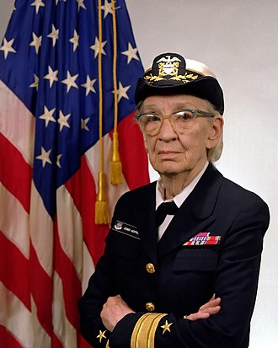
Rear Admiral Grace Murray Hopper
December 9, 1906 – January 1, 1992
PhD, Mathematics, Yale University, 1934
One of the first programmers of the Harvard Mark I computer, she was a pioneer in computer programming who invented one of the first linkers.
She popularized the idea of machine-independent programming languages, which led to the development of COBOL, an early high-level programming language still in use today.
Notes:
Met in 1974 – so we are really that close to the pioneers in computing.

Slide 39
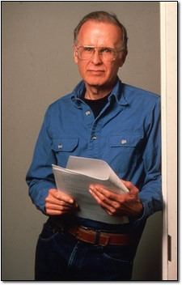
John Backus
Pioneered parsing techniques; co-creator of Backus-Naur Form (BNF) for describing formal grammars
The first FORTRAN (FORmula TRANslation) compiler was developed at IBM in 1957, by a team led by John Backus
FORTRAN was the first commercial compiler – it was an extra cost add-on when you bought an IBM computer
It is sometimes called the first modern compiler, because it employed formal grammar rules

Slide 40
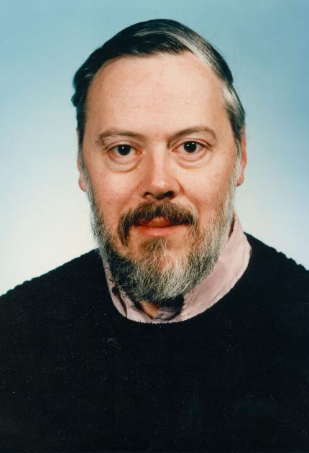
Dennis Ritchie
While working at Bell Labs, invented the C programming language
Co-invented the Unix Operating System (along with Ken Thompson)

Slide 41
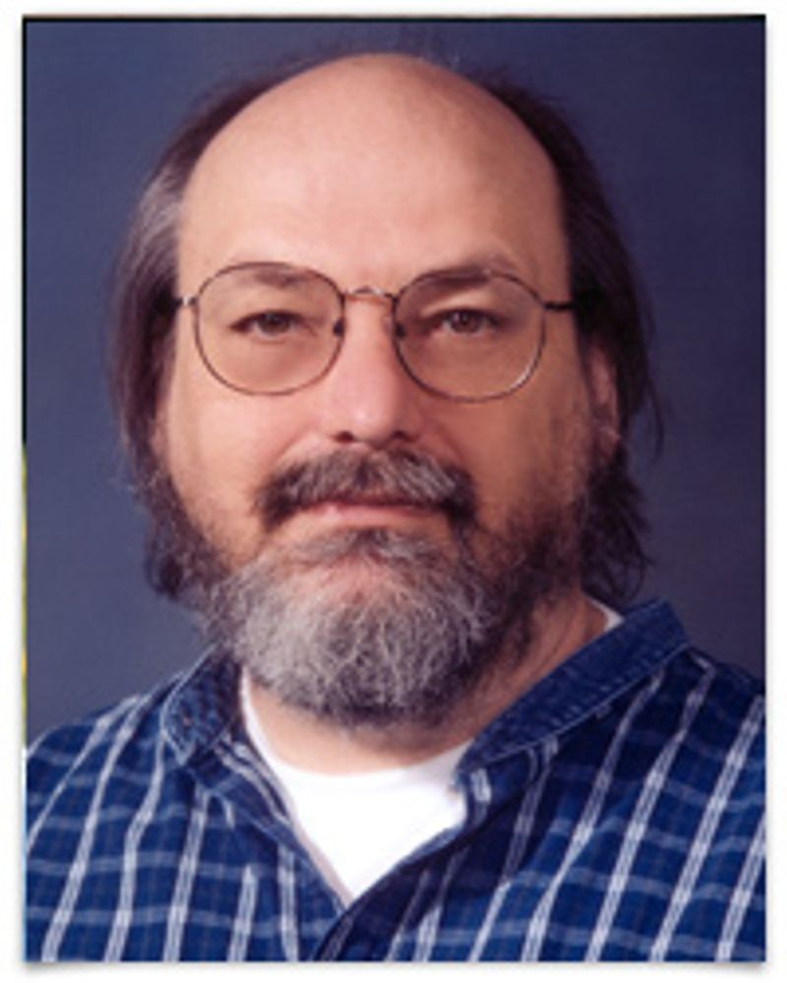
Ken Thompson
The first Unix shell, called sh, was developed by Ken Thompson at Bell Labs in 1971. Thompson, along with Dennis Ritchie, invented and popularized the Unix operating system. (Ritchie was also the inventor of the C programming language.)
Sh was completely rewritten by Stephen Bourne in 1979, who created the Bourne Shell. A number of spinoff and replacement shells were subsequently developed, including ksh, csh, tcsh, and bash.

Slide 42
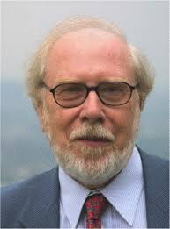
Nicklaus Wirth
P-code: may also refer to Pascal code – an early portable layer
PASCAL – 1970 – created by Swiss computer scientist Nicklaus Wirth as a highly structured instructional language; quickly replaced ALGOL as the teaching language of choice
First P-code emitter - 1973
UCSD P-Machine – 1977 – widely used in academia, as well as commercially

Slide 43
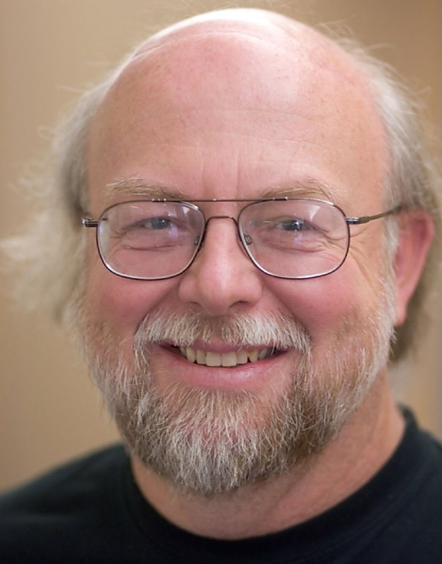
James Gosling
JVM (Java Virtual Machine): a virtual machine built by James Gosling and Brendan Eich – 1995 – specifically for Java - but now widely used
Virtual machine instruction set
Manages memory and system resources

Slide 44
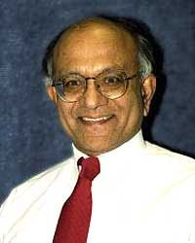
Abhay Bhushan
File Transfer Protocol (FTP)
One of the earliest client/server applications (early 1970s)
A graduate of the first class (1960–65) from the Indian Institute of Technology Kanpur
Masters in EE from MIT
Drafted RFC 114 – FTP
Contributed to the development of the ARPAnet and email protocols

Slide 45
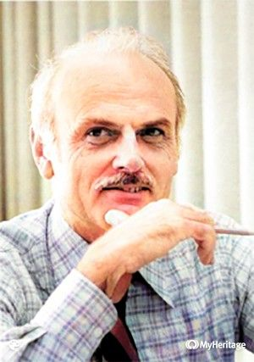
Ted Codd
The term "relational database" was invented by Dr. Edgar (Ted) Codd at IBM in 1970.
Codd introduced the term in his research paper "A Relational Model of Data for Large Shared Data Banks". In this paper and later papers, he defined what he meant by "relational".

Slide 46
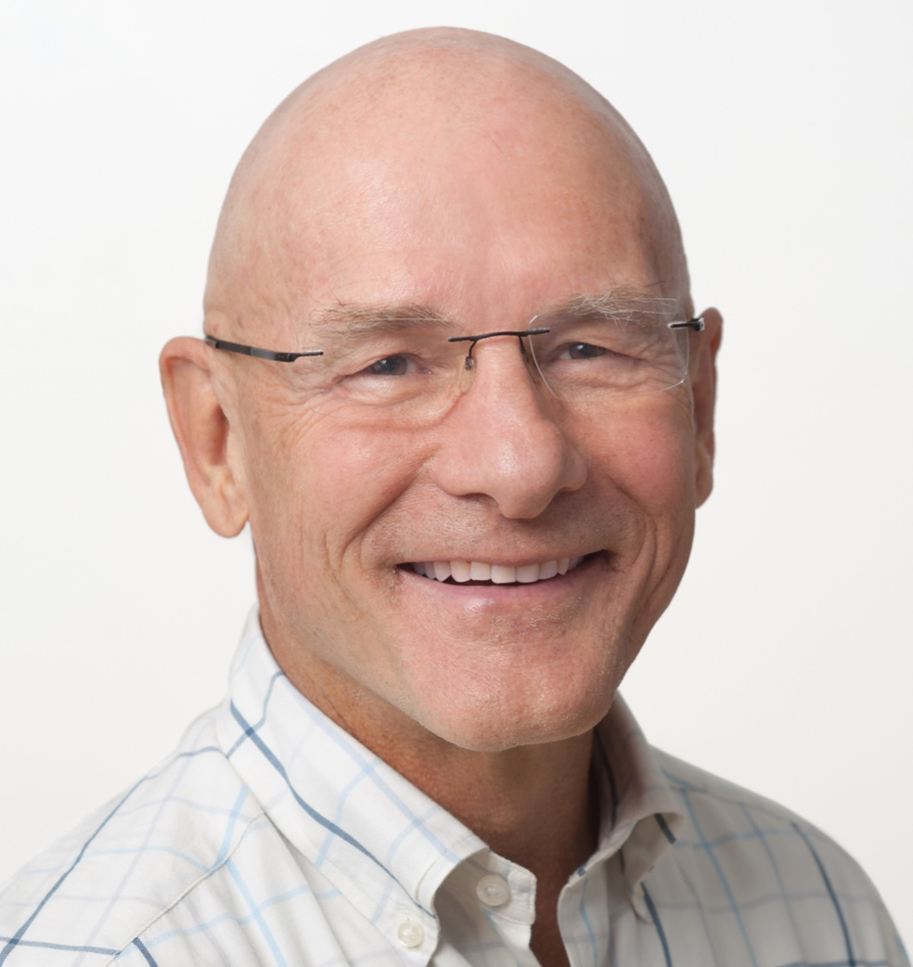
David Patterson
The Rise of RISC
In 1980, David Patterson at UC Berkeley outlined an architecture for a Reduced Instruction Set Computer, and coined the term RISC.
Fellow of the ACM
Fellow of the IEEE
Fellow of the Computer History Museum
ACM Distinguished Service Award
ACM-IEEE Eckert-Mauchly Award

